Slide 1
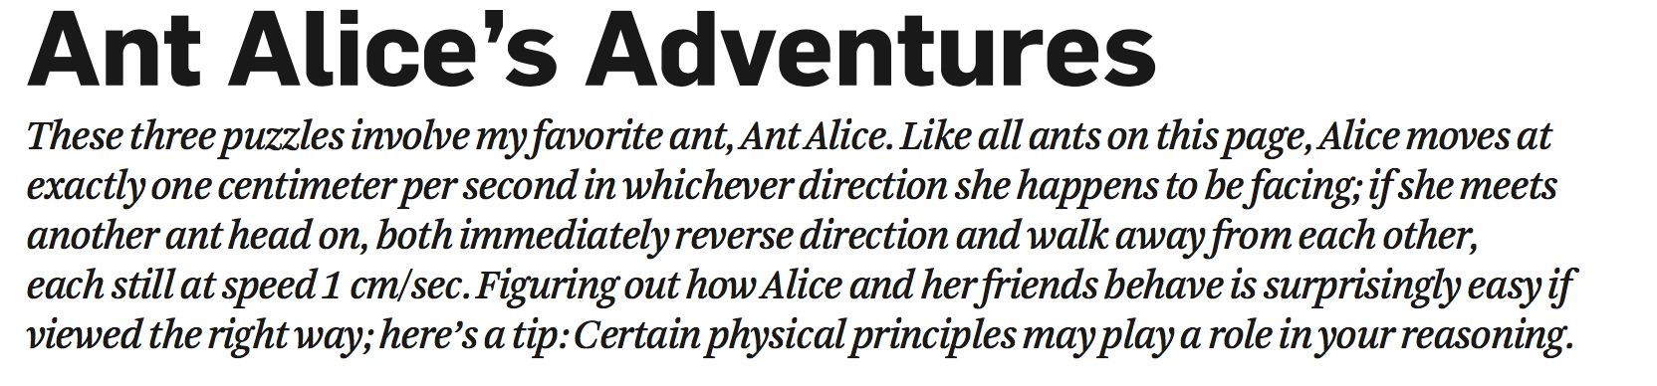
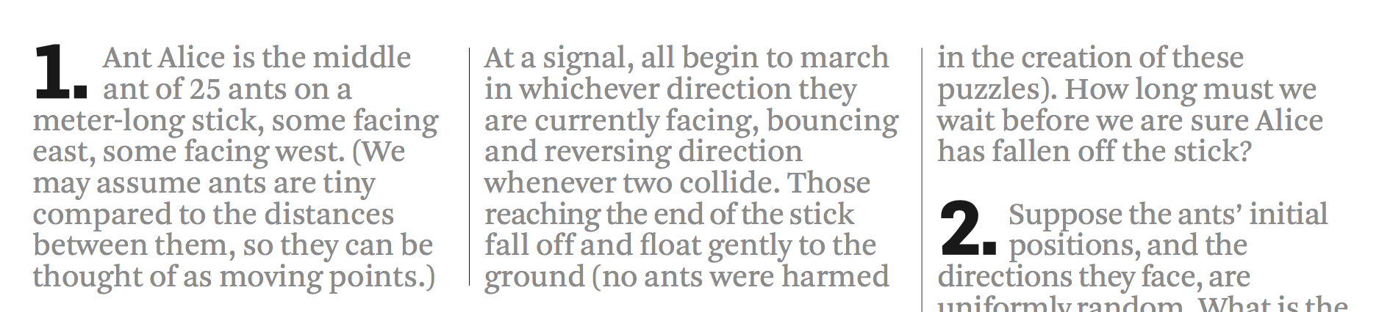
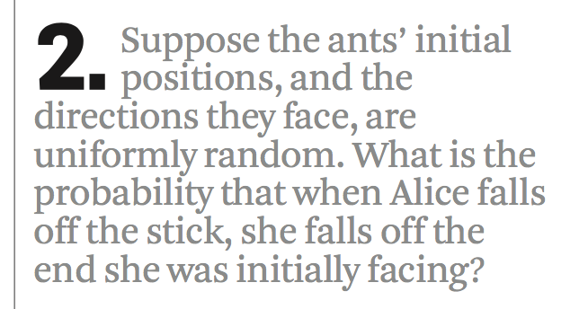
Notes:
Approximately 58%

Slide 2
Heapsort
张胜
sheng@nju.edu.cn
南京大学

Slide 3
In the last class…
Mergesort
Merge and its analysis
Worst Case Analysis of Mergesort
Lower Bounds for Comparison-based Sorting
Worst Case
Average Behavior

Slide 4
Heapsort
Heap Structure and Patial Order Tree Property
The Strategy of Heapsort
Constructing the Heap
Complexity of Heapsort
Accelerated Heapsort
Priority Queue
Notes:
*Quicksort rearranges elements in the original array (in-place), but cannot be sure of making an even subdivision of the problem.
*Mergesort can guarantee an even subdivision, but cannot rearrange the elements in the original array.

Slide 5
Tree
Level. The level of a node is defined as: 1 + the number of edges between the node and the root.
Depth. The depth of a node is defined as: the number of edges between the node and the root.
Height of node. The height of a node is the number of edges on the longest path between that node and a leaf.
Height of tree. The height of a tree is the height of its root node.

Slide 6
Heap: The Definition
A heap is:
A heap structure, satisfying
Partial order tree property
A binary tree T with depth h is a heap structure if:
T is complete at least through depth h-1
All leaves are at depth h or h-1
All path to a leaf of depth h are to the left of all path to a leaf of depth h-1
Partial order tree property
A tree T is a (maximizing) partial order tree if and only if the key at any node is greater than or equal to the keys at each of its children (if it has any).

Slide 7
Heap: Examples
max-heap
The maximal key is always at the root
50
9
24
30
5
7
20
21
18
3
1
4
3
6
12
5
6

Slide 8
What is the basic operation of HeapSort?
We use Partition to construct QuickSort.
We use Merge to construct MergeSort.
We use to construct HeapSort.
FixHeap

Slide 9
FixHeap: Keeping the Partial Order Tree Property
Input: A nonempty binary tree H with a “vacant” root and its two subtrees in partial order. An element K to be inserted.
Output: H with K inserted and satisfying the partial order tree property.
Procedure:
fixHeap(H,K)
if (H is a leaf) insert K into root(H);
else
Set largerSubHeap;
if (K.key≥root(largerSubHeap).key) insert K into root(H)
else
insert root(largerSubHeap) into root(H);
fixHeap(largerSubHeap, K);
return
One comparison:
largerSubHeap is left- or right-Subtree(H), the one with larger key at its root.
Special case: rightSubtree is empty
Recursion
“Vacant” moving down

Slide 10
fixHeap: an Example
vacant
24
30
24
30
20
21
18
3
20
21
18
3
12
5
6
12
5
K=6
30
30
24
18
24
20
21
3
20
21
18
3
12
5
K=6
12
5

Slide 11
Worst Case Analysis for fixHeap
2 comparisons at most in one activation of the procedure
The tree height decreases by one in the recursive call
So, 2h comparisons are needed in the worst case, where h is the height of the tree
Procesure:
fixHeap(H,K)
if (H is a leaf) insert K into root(H);
else
Set largerSubHeap;
if (K.key≥root(largerSubHeap).key) insert K into root(H)
else
insert root(largerSubHeap) into root(H);
fixHeap(largerSubHeap, K);
return
One comparison:
largerSubHeap is left- or right-Subtree(H), the one with larger key at its root.
Special case: rightSubtree is empty
Recursion
“Vacant” moving down

Slide 12
Heap Construction
Note: if left subtree and right subtree both satisfy the partial order tree property, then fixHeap(H,root(H)) gets the thing done.
We begin from a Heap Structure H:
void constructHeap(H)
if (H is not a leaf)
constructHeap(left subtree of H);
constructHeap(right subtree of H);
Element K=root(H);
fixHeap(H,K)
return
root
Post-order Traversal
left
right

Slide 13
Correctness of constructHeap
Specification
Input: A heap structure H, not necessarily having the partial order tree property.
Output: H with the same nodes rearranged to satisfy the partial order tree property.
void constructHeap(H)
if (H is not a leaf)
constructHeap(left subtree of H);
constructHeap(right subtree of H);
Element K=root(H);
fixHeap(H,K)
return
H is a leaf: base case, satisfied trivially.
Inductive Hypothesis
Notes:
可用数学归纳法对H包含的元素个数来证明

Slide 14

The Heap Is Constructed in Linear Time!
Number of nodes in right subheap
The recursion equation:
W(n)=W(n-r-1)+W(r)+2lg(n)
A special case: H is a complete binary tree:
The size N=2^{d}-1,
(then, for arbitrary n, N/2<n≤N≤2n, so W(n)≤W(N)≤W(2n) )
Note: W(N)=2W((N-1)/2)+2lg(N)
The Master Theorem applys, with b=c=2, and the critical exponent E=1, f(N)=2lg(N)
Note:
When 0<ε<1, this limit is equal to zero
So, 2lg(N)∈Ο(N ^{E-ε}), case 1 satisfied, we have W(N)∈Θ(N), so, W(n)∈Θ(n)
Cost of fixHeap
L’Hôpital’s Rule

Slide 15
The Heap is Constructed in Linear Time!
For your reference:
Master Theorem
case 1: If f(n)∈O(n^{E-ε}) for some positive ε, then T(n)∈Θ(n^{E})
Number of nodes in right subheap
The recursion equation:
W(n)=W(n-r-1)+W(r)+2lg(n)
A special case: H is a complete binary tree:
The size N=2^{d}-1,
(then, for arbitrary n, N/2<n≤N≤2n, so W(n)≤W(N)≤W(2n) )
Note: W(N)=2W((N-1)/2)+2lg(N)
The Master Theorem applys, with b=c=2, and the critical exponent E=1, f(N)=2lg(N)
Note:
When 0<ε<1, this limit is equal to zero
So, 2lg(N)∈Ο(N ^{E-ε}), case 1 satisfied, we have W(N)∈Θ(N), so, W(n)∈Θ(n)
Cost of fixHeap
L’Hôpital’s Rule

Slide 16
Heapsort: the Strategy
heapSort(E,n)
Construct H from E, the set of n elements to be sorted;
for (i=n;i≥1;i--)
currentMax = getMax(H);
deleteMax(H);
E[i] = currentMax;
deleteMax(H)
Copy the rightmost element on the lowest level of H into K;
Delete the rightmost element on the lowest level of H;
fixHeap(H,K)

Slide 17
Implementing Heap Using Array
50
9
24
30
5
7
20
21
18
3
1
4
3
6
9
5
7
1
4
3
6
12
5
6
50
24
30
20
21
18
3
12
5
6

Slide 18
Looking for the Children Quickly
数组下标从1开始
50
Starting from 1, not zero,
then the j th level has 2^{j-1}
elements. and there are
2^{j-1}-1 elements in the proceeding
i-1 levels altogether.
So, If E[i] is the kth element
at level j, then i=(2^{j-1}-1)+k,
and the index of its left child
(if existing) is
i+(2^{j-1}-k)+2(k-1)+1=2i
Level也从1开始
24
30
20
21
18
3
12
5
6
50
24
30
20
21
18
3
12
5
6
<5>
<10>
For E[i]:
Left subheap: E[2i]
right subheap: E[2i+1]
The number of children of the nodes on level j on the left of E[i]
The number of node on the right of E[i] on level j

Slide 19
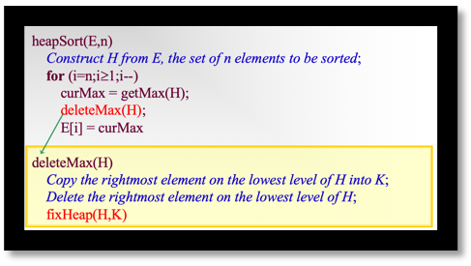
In-space Implementation of Heapsort
Heap implemented as a array (initial)
E[1]: The largest key to be moved to E[n]
E[n]→K: removed to be inserted
Sorted portion
E[1]: The largest key in current heap, to be moved to E[heapsize]
E[heapsize]→K: removed to be inserted
Current heap:
processed by fixHeap

Slide 20
fixHeap Using Array
Void fixHeap(Element[ ] E, int heapSize, int root, Element K)
int left=2*root; right=2*root+1;
if (left>heapSize) E[root]=K; //Root is a leaf.
else
int largerSubHeap; //Right or Left to filter down.
if (left==heapSize) largerSubHeap=left; // No right SubHeap.
else if (E[left].key>E[right].key) largerSubHeap=left;
else largerSubHeap=right;
if (K.key≥E[largerSubHeap].key) E[root]=K;
else { E[root]=E[largerSubHeap]; //vacant filtering down one level.
fixHeap(E, heapSize, largerSubHeap, K); }
return

Slide 21
Heapsort: the Algorithm
Input: E, an unsorted array with n(>0) elements, indexed from 1
Sorted E, in nondecreasing order
Procedure:
void heapSort(Element[] E, int n)
int heapsize
constructHeap(E,n,root)
for (heapsize=n; heapsize≥2; heapsize--;)
Element curMax=E[1];
Element K=E[heapsize];
fixHeap(E,heapsize-1,1,K);
E[heapsize]=curMax;
return;
New Version

Slide 22
Worst Case Analysis of Heapsort
We have:
It has been known that:
Recall that:
So, W(n) ≤ 2nlgn + Θ(n), that is W(n)∈Θ(nlogn)
Coefficient doubles that of mergeSort approximately

Slide 23
heapSort: the Right Choice
For heapSort, W(n) ∈ Θ(nlgn)
Of course, A(n) ∈ Θ(nlgn)
More good news: heapSort is an in-space algorithm (using iteration instead of recursion)

Slide 24
Let us improve HeapSort now!
W(n) ≤ 2nlgn + Θ(n)
It will be more competitive if only the coefficient of the leading term can be decreased to one.
How to decrease it to one?

Slide 25
The input of fixHeap
vacant
24
30
K=20
20
21
3
18
12
5

Slide 26
Number of Comparisons in fixHeap
2 comparisons are done in filtering down for one level.
Procesure:
fixHeap(H,K)
if (H is a leaf) insert K in root(H);
else
Set largerSubHeap;
if (K.key≥root(largerSubHeap).key) insert K in root(H)
else
insert root(largerSubHeap) in root(H);
fixHeap(largerSubHeap, K);
return

Slide 27
The input of bubbleUpHeap
30
24
18
vacant
K=20
20
21
3
12
5

Slide 28
A One-Comparison-per-Level Fixing
Bubble-Up Heap Algorithm:
void bubbleUpHeap(Element []E, int root, Element K, int vacant)
if (vacant==root) E[vacant]=K;
else
int parent=vacant/2;
if (K.key≤E[parent].key)
E[vacant]=K
else
E[vacant]=E[parent];
bubbleUpHeap(E,root,K,parent);
Bubbling up from vacant through to the root, recursively

Slide 29
How to transform the input of fixHeap into that of bubbleUpHeap?
K=20
vacant
30
24
18
vacant
24
30
？
20
21
3
20
21
3
18
12
5
12
5

Slide 30
Risky FixHeap
In fact, the “risk” is no more than “no improvement”
“Vacant” filtering down:
left vs. right
90
90
65
80
65
80
75
70
75
70
35
60
35
25
60
25
50
Element(55) to be inserted bubling up: element vs. parent
45
50
45
40
40
15
15

Slide 31
Improvement by Divide-and-Conquer
“Vacant” filtering down only half-way
90
90
65
65
80
80
75
70
75
70
35
35
25
60
60
If the element is smaller, filtering down half-half-way
25
45
50
45
50
40
15
40
15
The bubbling up will not beyond last vacStop

Slide 32
Improvement by Divide-and-Conquer
90
80
65
70
75
60
35
25
50
45
40
15

Slide 33
Depth Bounded Filtering Down
int promote(Element [ ] E, int hStop, int vacant, int h)
int vacStop;
if (h≤hStop) vacStop=vacant;
else if (E[2*vacant].key≤E[2*vacant+1].key)
E[vacant]=E[2*vacant+1];
vacStop=promote(E, hStop, 2*vacan+1, h-1);
else
E[vacant]=E[2*vacant];
vacStop=promote(E, hStop, 2*vacant, h-1);
return vacStop
Depth Bound
Notes:
第1次hStop一般设为h/2，表示将空位下降至一半高度，也就是提升一半的高度。
第2次hStop再下降h’/2（也就是h/4），……

Slide 34
fixHeap Using Divide-and-Conquer
void fixHeapFast(Element [ ] E, Element K, int vacant, int h) //h=⎡lg(n+1)⎤ - 1 in the uppermost call
if (h≤1) Process heap of height 0 or 1;
else
int hStop=h/2;
int vacStop=promote(E, hStop, vacant, h);
int vacParent=vacStop/2;
if (E[vacParent].key≤K.key)
E[vacStop]=E[vacParent];
bubbleUpHeap(E, vacant, K, vacParent);
else
fixHeapFast(E, K, vacStop, hStop)
Notes:
Promote空位下降（一次当前高度的一半），bubbleUpHeap再以Promote下降到的点开始逐个提升。因此，需要执行若干次Promote，到达这个位置后，只要执行一次bubbleUpHeap

Slide 35
Number of Comparisons in the Worst Case for Accelerated fixHeap
Moving the vacant one level up or down need one comparison exactly in promote or bubbleUpHeap.
In a cycle, t calls of promote and 1 call of bubbleUpHeap are executed at most. So, the number of comparisons in promote and bubbleUpHeap calls are:
At most, lg(h) checks for reverse direction are executed. So, the number of comparisons in a cycle is at most h+lg(h)
So, for accelerated heapSort: W(n)=nlgn+Θ(nloglogn)

Slide 36
An example of using Heap & fixHeap

Slide 37
Max-Priority Queue
INSERT(S, x) inserts x into S (x should be in proper position).
MAXIMUM(S) returns the element with the largest key in S.
EXTRACT-MAX(S) removes and returns the element with the largest key in S.
INCREASE-KEY(S, x, k) increases the value of element x’s key to the new value k, which is assumed to be at least as large as x’s current value.
抽象数据类型是为了减轻人思考的负担，而不是为了减轻计算机执行的负担。关键是如何实现？

Slide 38
Implement: Array→Heap→Priority Queue
这里Max-Heapify(A,1)就是fixHeap(A,A[1])

Slide 39
Formal analysis of the worse case of accelerated heapsort by recursion tree* *不作要求

Slide 40
Recursion Equation of Accelerated heapSort
The recurrence equation about h, which is about ⎡lg(h+1)⎤
We can verify (by induction) that T(h)≥h, then:

Slide 41
Solving the Recurrence Equation by Recursive Tree
For sorting a sequence of size n, n cycles of fixHeap are executed, so:
n.(h+ ⎡lg(h+1)⎤)
T(h)
⎡h/2⎤+1
T(⎣h/2⎦)
⎡h/4⎤+1
T(⎣h/4⎦)
⎡h/8⎤+1
⎡lg(h+1)⎤ levels
So, the total cost is:
h+ ⎡lg(h+1)⎤
T(1)
1+1

Slide 42
Formal analysis of the worse case of accelerated heapsort by guess and prove *不作要求

Slide 43
Inductive Proof
The recurrence equation for fixHeapFast is
Proving the following solution by induction:
T(h) = h+⎡lg(h+1)⎤
I. H.: T(h) = h+⎡lg(h+1)⎤
Let us verify T(h+1)
T(h+1)=⎡(h+1)/2⎤+1+T(⎣(h+1)/2⎦)
Applying the I.H. o the last term, we have
T(h+1)=⎡(h+1)/2⎤+1+⎣(h+1)/2⎦+ ⎡lg(⎣(h+1)/2⎦+1)⎤
=h+1+[1+ ⎡lg(⎣(h+1)/2⎦+1)⎤]=h+1+ ⎡lg(h+2)⎤
(It can be proved that for any positive integer:
⎡lg(⎣(h)/2⎦+1)⎤+1= ⎡lg(h+1)⎤

